Slide 1
The TMF Reference Model Launched
10th June 2010

Slide 2
Disclaimer
The views and opinions expressed in the following PowerPoint slides are those of the individual presenter and should not be attributed to Drug Information Association, Inc. (“DIA”), its directors, officers, employees, volunteers, members, chapters, councils, Special Interest Area Communities or affiliates, or any organization with which the presenter is employed or affiliated.
These PowerPoint slides are the intellectual property of the individual presenter and are protected under the copyright laws of the United States of America and other countries. Used by permission. All rights reserved. Drug Information Association, DIA and DIA logo are registered trademarks or trademarks of Drug Information Association Inc. All other trademarks are the property of their respective owners.

Slide 3
Agenda
The Trial Master File
Overview of TMF Reference Model
rationale
background and development
review
Industry perspective
Version 1.0 launch and next steps

Slide 4
Presenters
Karen Redding (Roy) – Co-leader, Phlexglobal, CRO
Lisa Mulcahy – Co-leader, Mulcahy Consulting
Ivan Walrath – Pfizer
Carol Smith – Cephalon
Fran Ross - Genzyme

Slide 5
What is the trial master file?
The documentation referred to in Article 15(5) of Directive 2001/20/EC as the trial master file shall consist of essential documents, which enable both the conduct of a clinical trial and the quality of the data produced to be evaluated
[European Directive 2005/28/EC]

Slide 6
What is the trial master file?
The trial master file shall consist of essential documents, which enable both the conduct of a clinical trial and the quality of the data produced to be evaluated.
[Rules governing medicinal products in the European Union, Vol. 10 NTA Clinical Trials]

Slide 7
What are “essential documents”?
Essential documents are those documents that individually and collectively permit evaluation of the conduct of a trial and the quality of the data produced. These documents serve to demonstrate the compliance of the investigator, sponsor, and monitor with the standards of GCP and with all applicable regulatory requirements.
[ICH GCP, Section 8.1]

Slide 8
ICH GCP Section 8.2 – 8.4
“The minimum list of essential documents that has been developed.....”
ICH GCP does NOT provide a comprehensive contents list
Confirmed explicitly by MHRA
Examples of missing documentation:
Electronic systems
Data Management
Statistical analysis

Slide 9
The Trial Master File
Supporting files e.g. computer SDLC files; GMP manufacturing files; vendor selection files
Minimum list of essential documents, as defined by ICH GCP, Chapter 8
Usually considered outside the scope of the TMF
The Trial Master File
Other trial-related records that “permit evaluation of the conduct of the trial and quality of data produced”
Other business records

Slide 10
Checklist
Is it identified specifically in ICH GCP?
Does it facilitate assessment of the conduct of the trial?
Does it provide evidence of following a quality control system?
Does it help to provide evidence of compliance with any GCP requirement?
Does it help to provide evidence of compliance with any other regulatory requirement?
Each company is left to interpret expanded content & variable names

Slide 11
EDM Reference Model
DIA Document and Records Management Special Interest Area Community initiative since 2008
Standardization effort for the industry with eCTD backbone
Version 1 launched in 2008, version 2 in the works
Extensions of the model are in development
Interconnects with this initiative in trial related submission documentation
Ensure common taxonomy and metadata
TMF has wider applicability than EDM Reference model

Slide 12
TMF Reference Model Goals
Standard contents
Industry opinion on what is kept in a TMF
Standard naming
Based off the ICH E6 Section 8 terminology and industry accepted terminology
Standard structure
It doesn’t have to be folder-based or departmentalized like in a paper system
Standard metadata
If TMF is an EDMS, what would be the basics – at system and artifact level?
Notes:
This slide gives an high-level description of how we currently file TMF documents
12

Slide 13
1.5 years of Accomplishments
Dec08-Feb09
DIA EDM meetings to recruit team members
Mar09
Inaugural meeting and charter created
May09
TMF split into zones, Leads and members organized
Aug09
First pass at expTMF contents (artifacts) and naming
Sep09
Feedback from TMF reference model members and extended review team
Feb10
Artifacts narrowed, definitions added, requirement level and metadata requirements in refinement
Notes:
Dec 2008 – Feb 2009 – DIA EDM meetings to talk up the topic and recruit team
March 2009 –
May 2009 -
Aug 2009 –
Sept 2009 –
Dec 2009 –
13

Slide 14
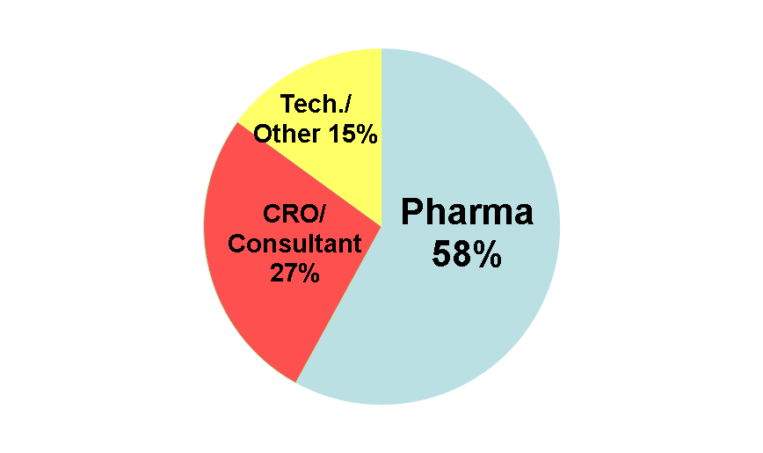
Who is involved?
123 members
48% US, 52% EU
90 Companies
Pharma
CRO
Vendor
Regulatory Agency input
MHRA
FDA
Notes:
14

Slide 15
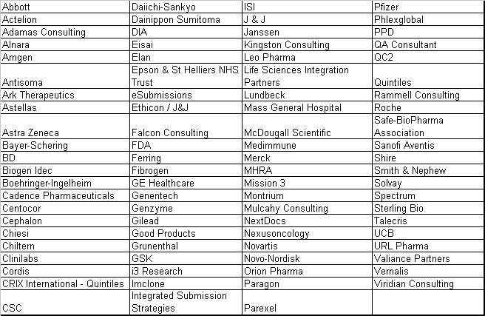
Company involvement

Slide 16
How Work on the Model is Organized
11 Zones and 222 Artifacts
Trial Management
Central Trial Documents
Regulatory
IEC / IRB and Other Approvals
Site Management
Trial Supplies
Safety Reporting
Centralized Testing
Third Parties
Data Management
Statistics
Notes:
16

Slide 17
Beyond the ICH Minimal list
Each artifact assigned 1 of the following:
Core – must be in the TMF as dictated by either the regulations or the TMF Reference Model group
E.g. IRB/IEC approval documentation
Recommended – does not have to be produced but if it is created or collected, it is recommended to be in the TM
E.g. Data Management Plan

Slide 18
TMF Reference Model
Version 1.0 launched

Slide 19
Plan for Release
DIA Webinar 10th June 2010 – today!
Email sent to all DIA members pre Annual meeting
Official launch at DIA annual meeting on 13th June
Linked in group (TMF Reference Model)
Mechanism for feedback
Regulatory bodies
Sponsors
Vendors

Slide 20
Future Plans
Coordinated vendor feedback of the utilization of the model
Technical Guide & Communication Plan
Device Studies
Early phase studies
Investigator Initiated Studies
Regional expansive view and model update

